Slide 1
IMRS-Movie recommendation system
A Content-Based ML System for Indian Cinema
BT24F05F002 - Aditya Khamkar
BT24F05F006 - Chaitanya Bakhal
BT24F05F00 - Amaan Chaudhari

Slide 2
Project Overview
🎯 Problem
Discovering good Indian movies is hard. Users need personalized recommendations beyond generic lists.
💡 Solution
A smart ML-powered system that understands user taste and recommends similar Indian films instantly.
🎬 Impact
Supports both Bollywood and regional cinema, making Indian film discovery easy and personalized.

Slide 3
Key Features
Content-Based Recommendations : Uses TF-IDF vectorization and cosine similarity to match movies based on genre, director, and cast.
Advanced Filtering : Filter results by genre, actor, director, and IMDb rating range for more refined suggestions.
Movie Posters & Details : Integrated OMDB API fetches movie posters and additional metadata in real-time.
Simple Web UI : Built with Streamlit for a clean, responsive, and easy-to-use web interface.
Regional Coverage : Covers both Bollywood and regional Indian films for wide cultural representation.

Slide 4






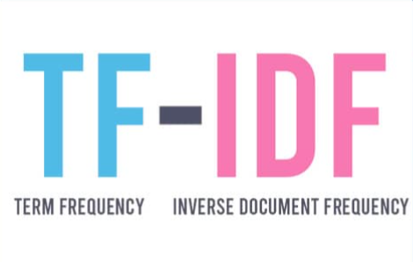

Technologies Used

Slide 5
How It Works
1. Data Processing
Movie features (genre, director, actors) are combined into unified text strings per movie.
2. TF-IDF Vectorization
Text strings are converted into numerical vectors using Term Frequency-Inverse Document Frequency.
3. Cosine Similarity
The angle between feature vectors is measured to find movies closest in content to the selected film.
4. Recommendation
Top 100 similar movies are retrieved, then filtered by user preferences (genre, actor, rating).
5. API Integration
OMDB API fetches real-time movie posters and additional metadata for each recommendation.

Slide 6
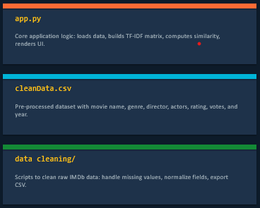
Project Structure
IMRS/
├── app.py # Main Streamlit application
├── cleanData.csv # Cleaned movie dataset
├── requirements.txt # Python dependencies
├── README.md # Project documentation
└── data cleaning method/
├── dataCleaning.py # Data cleaning script
└── IMDbRatings_IndianMovies.csv # Raw dataset

Slide 7
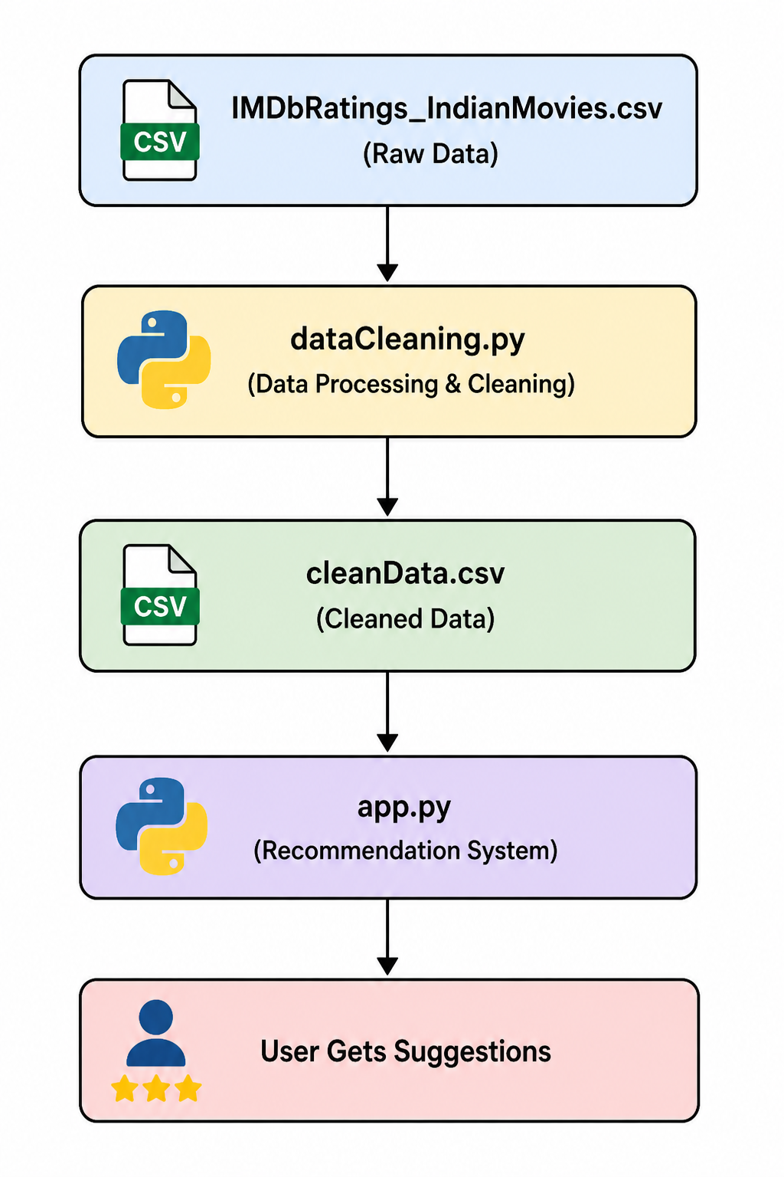
Work Flow OR Flowchart

Slide 8
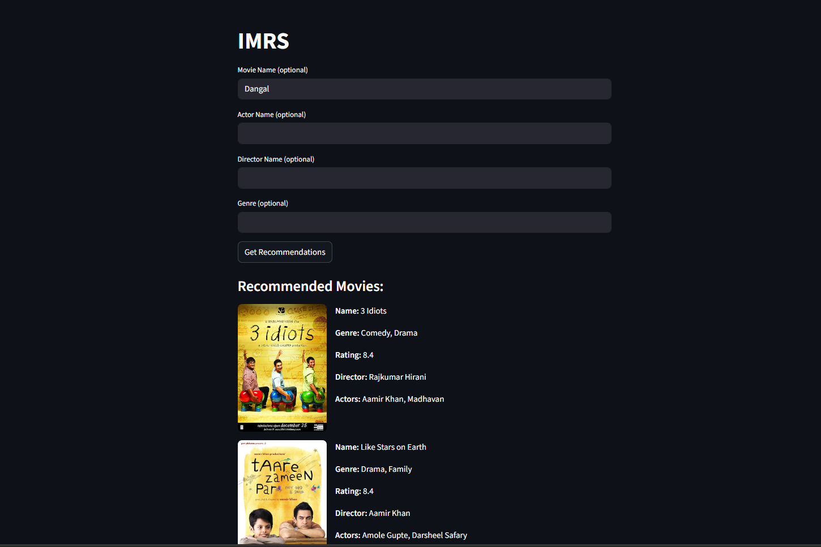
Application Interface
How to use
Select a movie you enjoy.
Apply optional filters.
Click “Get Recommendations”.
4. Browse your personalized list.

Slide 9
Conclusion And Future Scope
Conclusion
Future Scope
Content-based ML for accurate, personalized recommendations
Covers Bollywood + regional Indian cinema comprehensively
Real-time OMDB API for movie posters and metadata
Advanced multi-filter search for refined results
Streamlit UI - no technical knowledge required to use
Open source and easily extensible with new datasets
Collaborative filtering with user data
Multi-language regional support
Mobile app version
Deep learning embeddings
User ratings & feedback loop

